Slide 1

Rodrigo Rocha, 71731
Rodrigo Relvas, 71860
João Pedro, 80098
Fábio Nunes, 80139
Diana Silva, 80239
Susana Dias, 80410
PEI 2018-2019
Mestrado Integrado em Engenharia de Computadores e Telemática
Notes:
PRESENT THE GROUP:
RODRIGO, RODRIGO, FÁBIO, JOÃO, DIANA, SUSANA
MENTION MENTORS: keeping up with our work and helping PEDRO COSTA
CTO LÚCIA BILRO
CEO ROGÉRIO NOGUEIRA

Slide 2
Monitoring the winemaking process is quite time/resource consuming;
Revenue loss;
Notes:
MONITORING WINEMAKING TAKES A LOT OF TIME AND RESOURCES
DOING IT MANNUALY CAN CAUSE HAVING A Late reaction and A LOSS monitoring LEADING to A lower wine quality
SEND DATA TO THE WEB APP
THIS IS WHERE WE ENTER

Slide 3
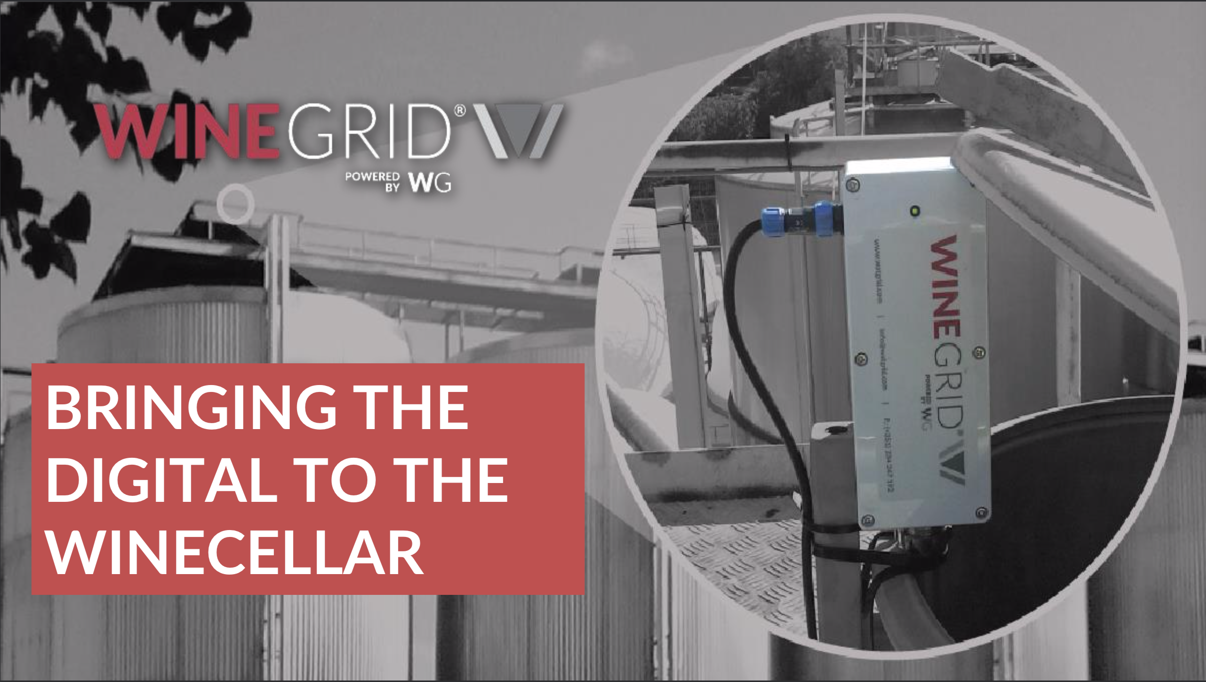
Notes:
WINEGRID CAME UP WITH A SENSOR THAT CAN BE IMPLEMENTED IN THE WINE CELLARS

Slide 4
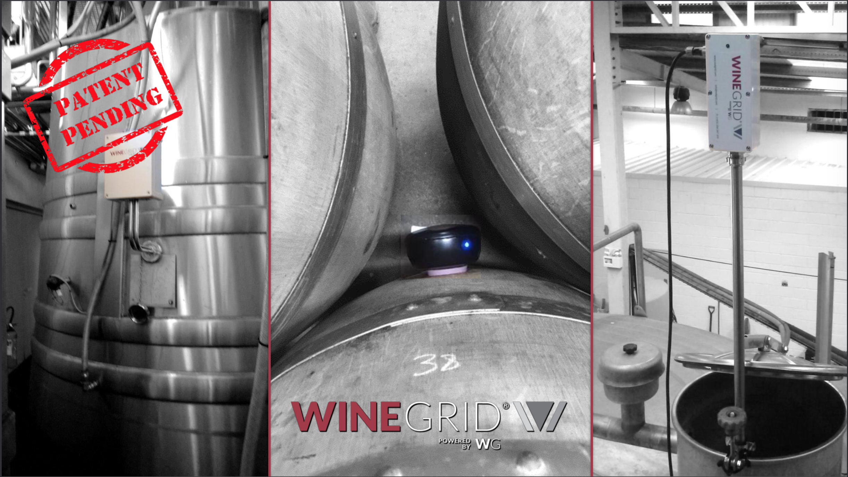
Notes:
HERE ARE SOME EXAMPLES OF THE SENSORS ON THE WINE CELLARS

Slide 5
Real time data of:
Density;
Temperature;
Color;
Turbidity;
Level;
Notes:
THEY CAN COLLECT REAL TIME DATA OF: ..
THEIR COMPETITION ONLY MESURES TEMPERATURES

Slide 6
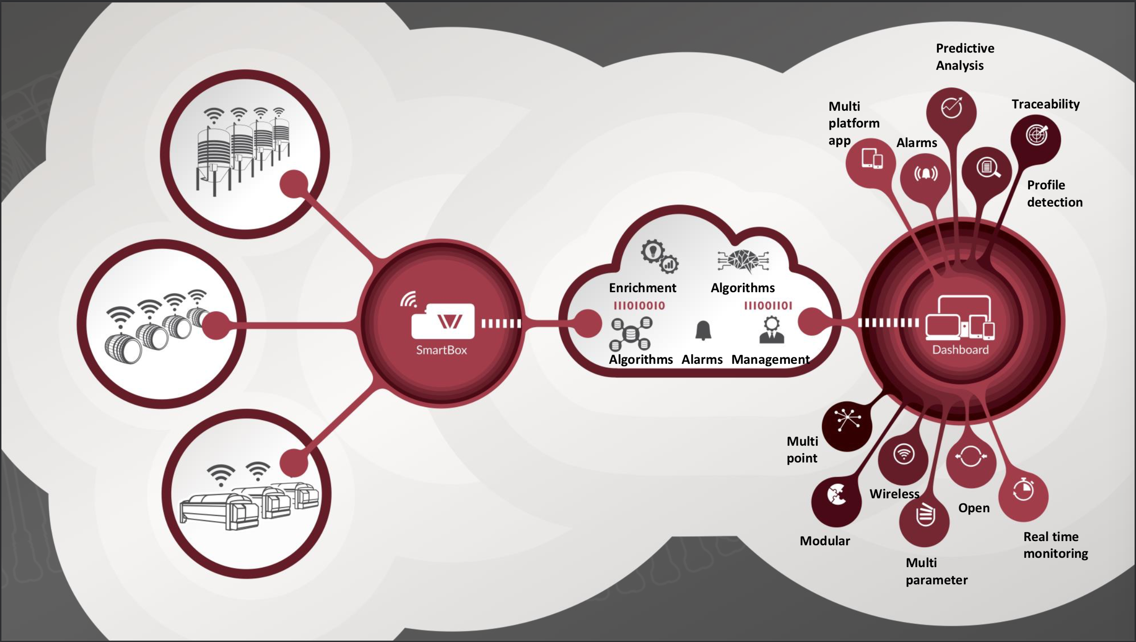
Notes:
AS YOU CAN SEE IN THIS SCREEN THEY HAVE IMPLEMENTED ALL WIRELESS CONNECTIONS AND THIS IS WHERE WE ENTER

Slide 7
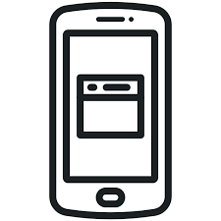

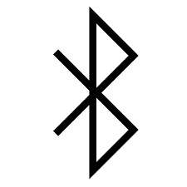
Our challenge
Mobile app
Data analysis
Bluetooth Low Energy server
Notes:
OUR CHALLENGE IS:
DEVELOP MOBILE APP TO CONNECT SENSOR VIA BLE
PAIRING THROUGH BAR CODE OR QR CODE
DATA ANALYSIS OF GRAPHICS CREATED WITH THE DATA COLLECTED

Slide 8
2nd Demo - new features
Bluetooth Low Energy server
Improved security with diffie-hellman algorithm
Mobile app
Bug fixes and some adjustments
List process
Process detail
Stop Process
Data analysis
Process detection while analysing the curves
Notes:
SOME NEW FEATURES IMPLEMENTED

Slide 9
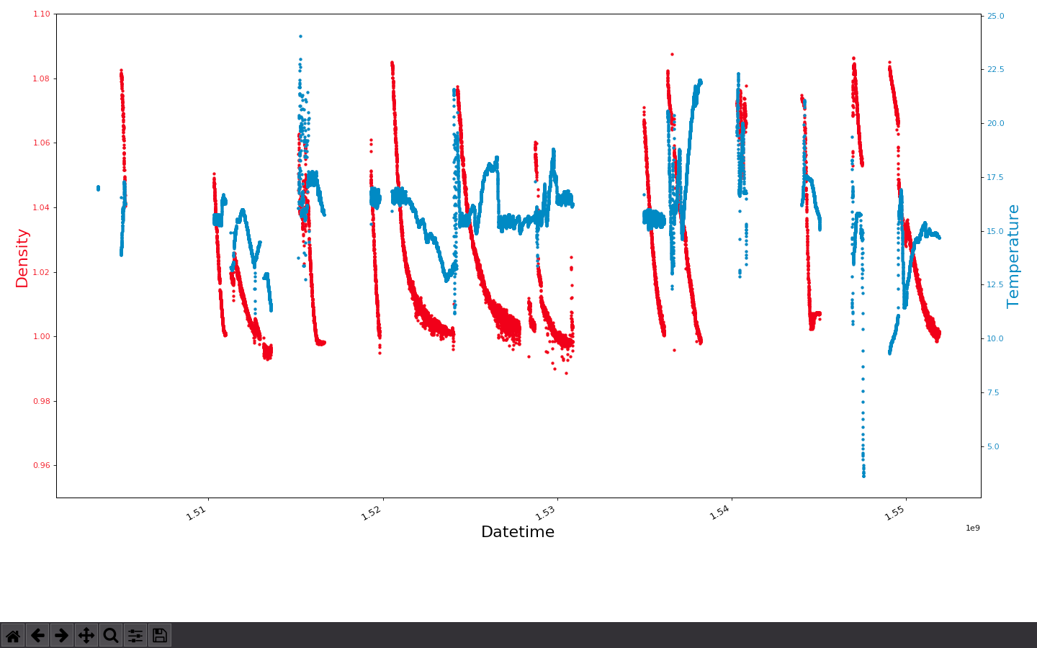

Slide 10
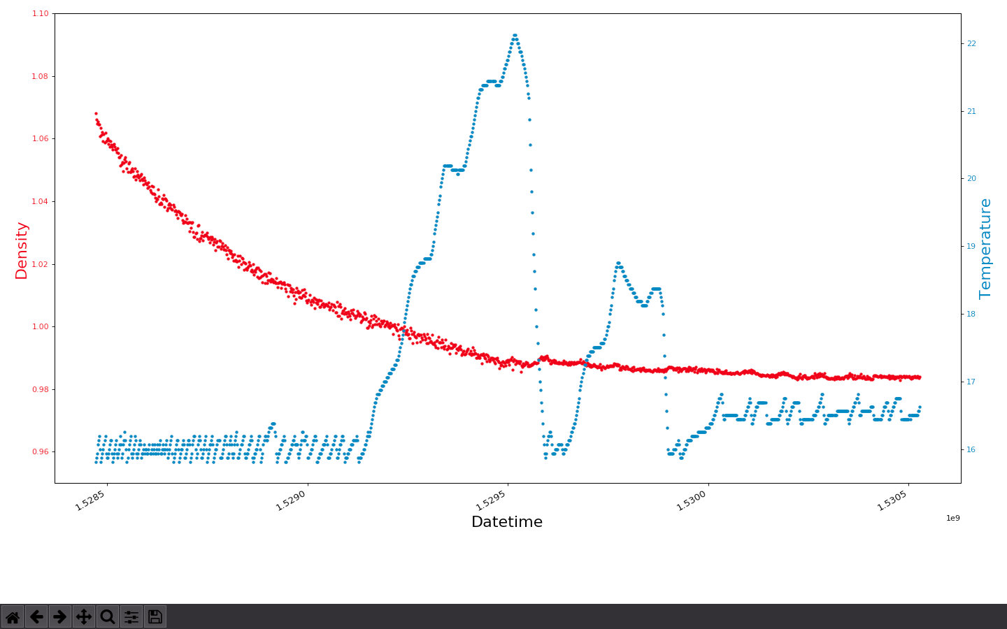

Slide 11
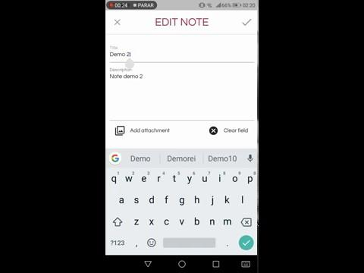

Slide 12
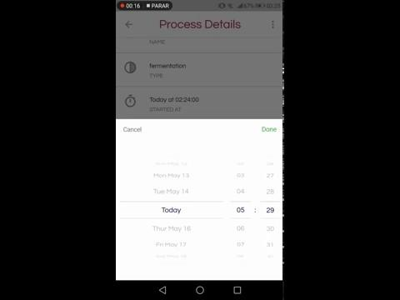

Slide 13
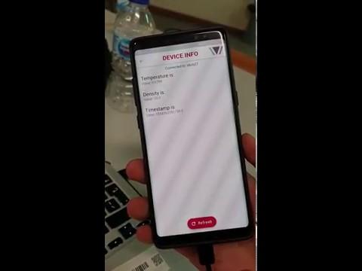
Please Murphy be good to us!
Notes:
IN CASE MURPHY FAILS US

